Slide 1
Presentation
On
The summary of chapter one and two
Of
Twenty Thousands Leagues Under the Sea
By
Jules Verne
Department: Computer Science and Engineering
Course Title: English for Academic Purposes
Course Code: EAP-102
Course Section: D4
Course Teacher: Mohammad Osman Farhan Al Harun
Green university of Bangladesh
ALLPPT.com _ Free PowerPoint Templates, Diagrams and Charts

Slide 2
Group Details
Macbeth
Sk. Sanjidul Haque
ID: 162002038
Md. Maskawath Latif
ID: 162002024
Hossain Mohammed Rhidoy
ID: 162002003
Md. Rahamat Jahan
ID: 162002025
02

Slide 3
First Session
About the writer and the book
Presenter: Sk. Sanjidul Haque
ID: 162002038
03

Slide 4
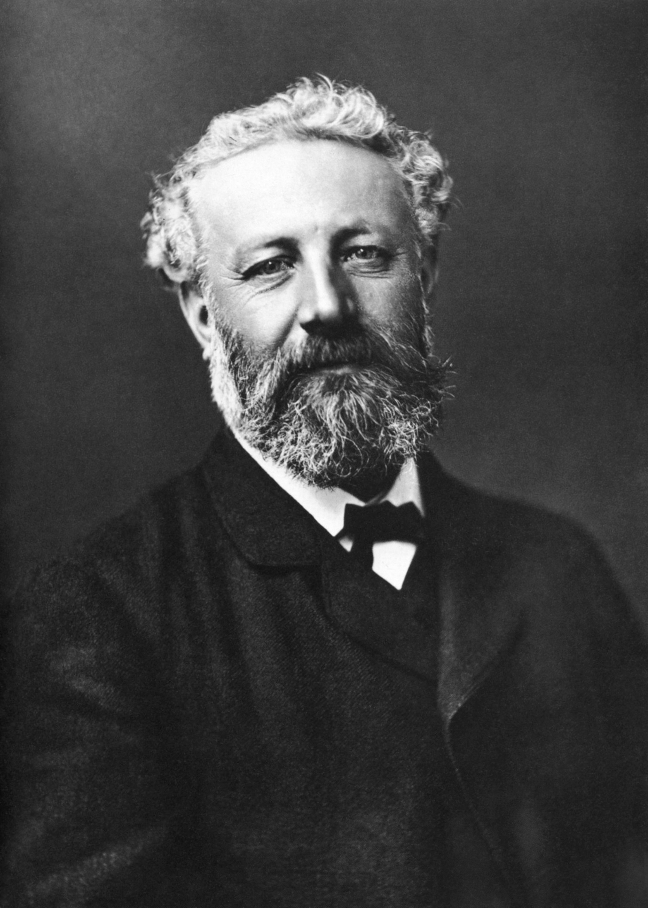
Jules Verne
Jules Gabriel Verne, France,
1828.
1847, Paris, law school.
Novelist, poet and playwright.
Voyages Extraordinaires series.
Diabetes, France, 1905.
Jules Verne
04

Slide 5

Twenty Thousands Leagues Under the Sea
1870, premiere adventure novel.
1873, In English, Lewis Page
Mercier.
1866, ships, narwhal.
Nautilus, earliest successful
submarines.
1874, The Mysterious Island.
05

Slide 6
Second Session
Main Characters
Presenter: Md. Maskawath Latif
ID: 162002024
06

Slide 7
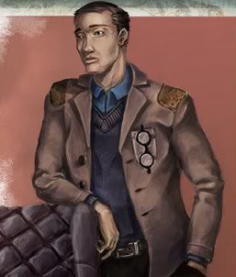
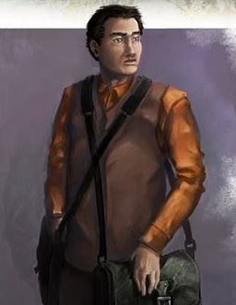
Main Characters
Doctor Pierre Aronnax; a sea book
writer, a thinker and also a wise man;
works at a museum.
Conseil; a good servant of Dr. Aronnax, a hardworking man and also likes
to help people.
07

Slide 8
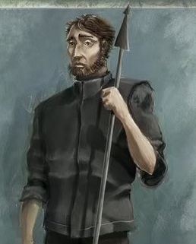
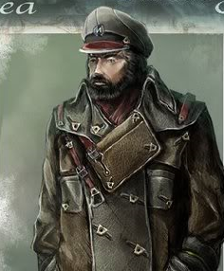
Main Characters
Ned Land; a Canadian whaler and
master harpoonist, also a rude man.
Captain Nemo; captain of Nautilus,
doesn’t like people and also a sea lover.
08

Slide 9
Third Session
Some Important Words
Presenter: Hossain Mohammed Rhidoy
ID: 162002024
09

Slide 10
Some Important Words
Monster
A big animal that is very bad to look at and
makes people afraid.
Whale
A very big animal that lives in the sea
and looks like a fish.
Harpoon
People kills whale with this long thin
thing.
Surface
The highest part of something.
10

Slide 11
Some Important Words
Bed
The land under the sea; a place where shellfish live under the sea.
Shell
The hard outside part of a small
animal
Piano
We play music on this with our hands.
Island
A country in the sea.
11

Slide 12
Last Session
Summarization of Chapter One and Two
Presenter: Md. Rahamat Jahan
ID: 162002025
12

Slide 13
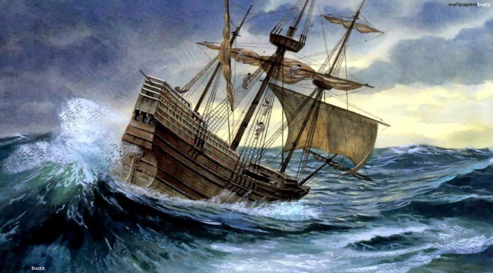
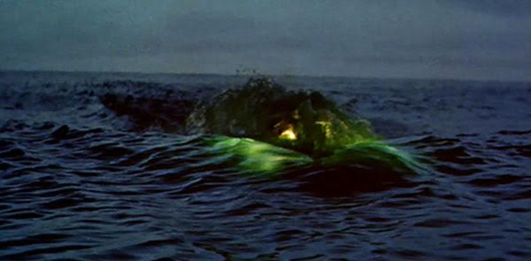
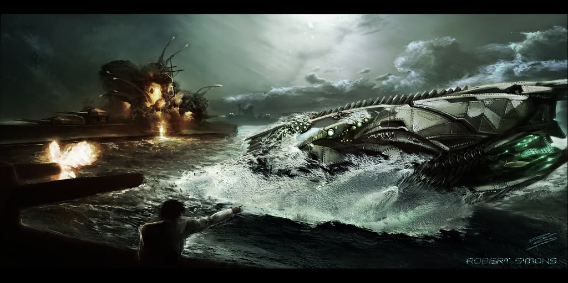
Chapter One: Looking for the monster
1866, a rumor was spread about
a sea monster.
Dr. Aronnax’s team went to
discover it.
Their team’s ship was attacked.
Three of them fell into the sea.
Discovering the monster as a
submarine and took shelter in it.
13

Slide 14
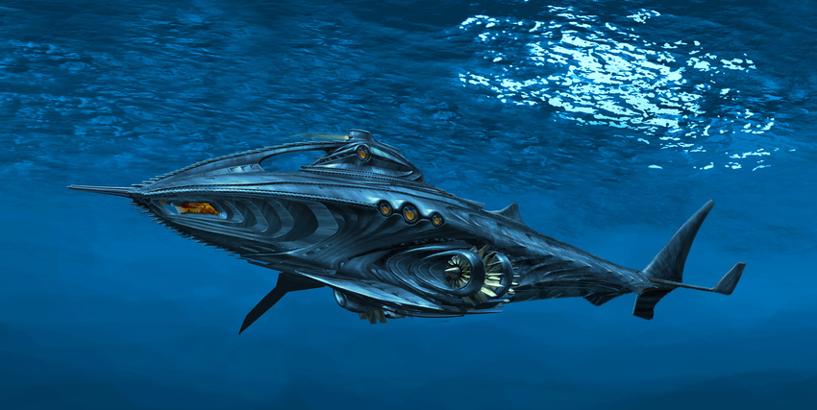
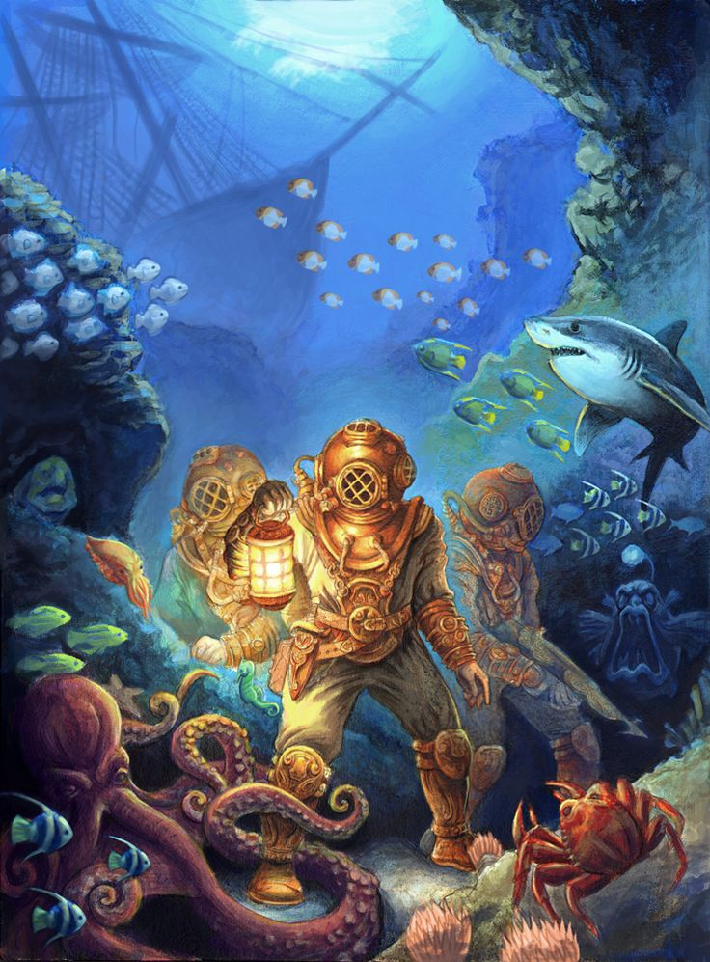
Chapter Two: Captain Nemo and the Nautilus
Captain Nemo confined Dr.
Aronnax’s team in Nautilis.
Applying some conditions to their team.
Travelling through the submarine.
Well furnished, many books.
Scuba diving and hunting under
the sea.
14

Slide 15

THANK YOU
FOR
WATCHING
OUR
SLIDE
15

Slide 16

Any Queries?
Feel Free to Ask!
16

